Slide 1
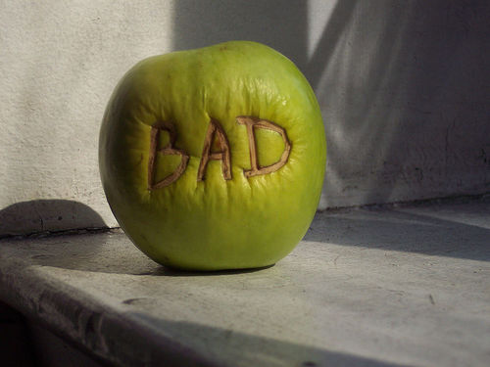
BAD APPLES

Slide 2
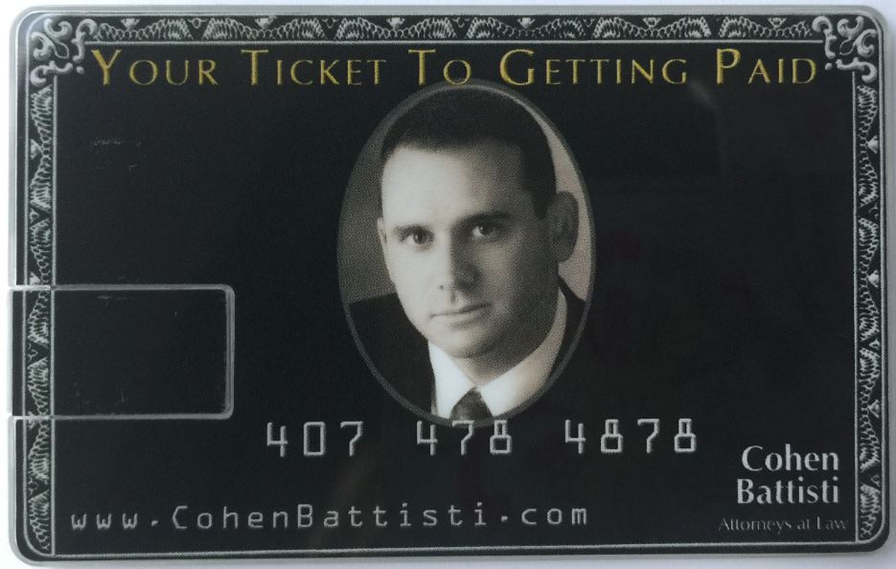
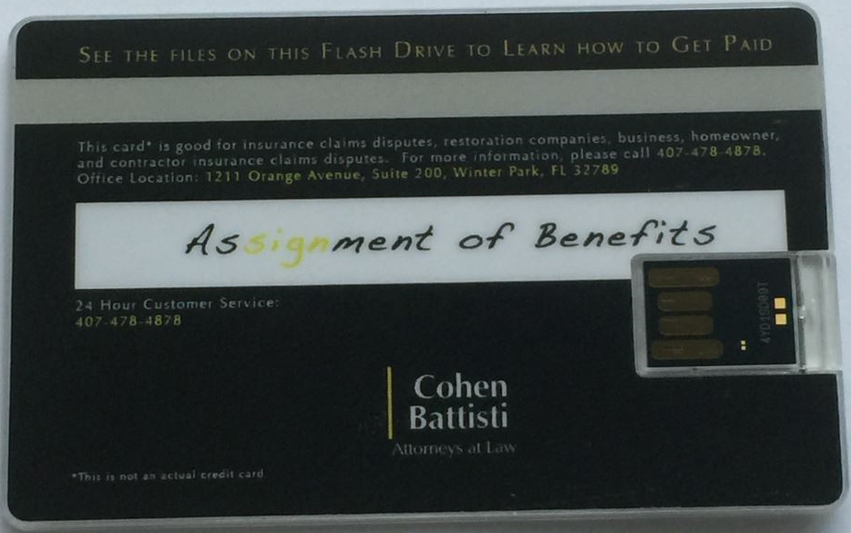
When did the AOB APPROACH TO FEES begin?
AOBs began years ago with PIP claims. In about 2010, attorneys promoted expansion of AOBs to other coverages, like property and comprehensive & collision.
The first significant spread seems tied to an inventive claims attorney who dubbed himself:
This attorney began widely promulgating the new AOB approach in 2010 by conducting seminars and sending mailers to repair vendors. The mailer included this imitation credit card with a zip drive of template AOBs for vendors to have consumers sign.

Slide 3
Johnny Appleseed’s AOB definition

Slide 4
ASSIGNMENT of BENEFITS
A legal tool that allows 3rd parties (VENDORS) to be paid directly from Insurers after a Claim.
Example: water leak scenario w/ inflated invoice
AOB lawsuit results & was the incentive due to the one-way attorney fee statute
The attorney fee’s are on top of the inflated invoice
Egregious consumer harm often results—www.fightfraud.today/resources
Issue is Keeping the Consumer from fronting money— Direction to pay vs. Assignment of Benefits

Slide 5
Differences– AOB vs. direction to pay
ASSIGNMENT OF BENEFITS
Conveys legal standing
Conveys ability to sue
Allows 3rd party to stand in the shoes of insured. Can’t talk to your insurer.
Bad faith becomes an option
Forfeiture of other rights—power of atty, waiver of all privacy rights, hold harmless, no insurer contact.
Exorbitant Cancellation Fee’s
DIRECTION TO PAY
Merely tells insurer how to pay
Conveys no legal standing
Can not bring suit under direction to pay
Bad faith, not an option

Slide 6
Additional Thoughts On AOB
Hides other transfers
Power of attorney, filing of a lien, waiver of “all” privacy rights, Hold Harmless, You cannot communicate with insurer, Etc.
ADVISING OTHERS
Never sign an AOB Contract
REFERRALS, lists, Endorsements
How do you know difference?
FAIA Solution (RYTECH)

Slide 7
AOB by the Numbers
2004 & 2005 – a period of 16 months with 8 storms & 3 million claims filed—NO AOB SUITS!
2006 the first (and only) AOB lawsuit was filed by a PA—following a 16 month period of 8 Hurricanes
2007 there were 405 AOB suits
In 2016 there were 28,000. An increase of 7,000% Today, including Auto Glass it’s over 100k annually.

Slide 8
MORE AOB Numbers
Since 2014 AOB lawsuits are up 186%, excluding Citizens.
First time—ATRA (in 16 yrs.) ranks Florida the worst “Judicial Hellhole” in America due to “an aggressive and sometimes LAWLESS plaintiffs bar.”
Last year: Frequency of water claims up 46%. Severity up 28%
January 2018 OIR data call report:
Larger progression of claims in half the time since prior report.
Frequency water claims up 44%. Severity 18%. Which means pure premium indication is up 42.1%.
Triple the prior report, just 12 months earlier.

Slide 9
“SOME” are BAD APPLES
Attorneys
Roofers
Public Adjusters
Plumbers
Water Remediators

Slide 10
WATER REMEDIATORS
HOW DO THEY GET CUSTOMERS?
Referrals: Plumbers, HOA’s, Condo Assoc. HWA’s
Plumbers: Cash referrals, Supply Houses, Substantial income.
Ms. Bloebaum Example
General Advertising & word of mouth

Slide 11
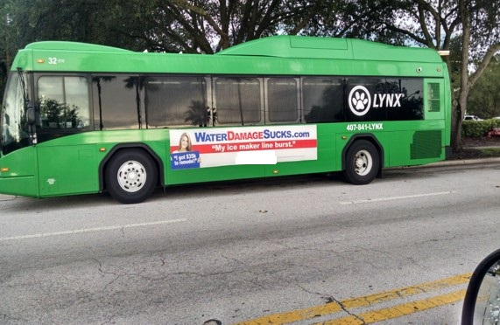
WATER REMEDIATION--Regulation “A MORAL HAZARD”
Regulation won’t solve the problem but, that doesn’t mean it’s not needed
Referral fees
Mold
BAD APPLES!!

Slide 14
NO REGULATION
“Angie” was arrested while on probation for years of insurance fraud
For embezzlement from an insurance agent (191 checks)
One count of organized fraud (felony) and 34 counts of grand theft
FDLE criminal report was 47 pages long
She owned five (5) different water firms. Brother owned even more. She now owns 8.
The day after she was arrested she files an AOB lawsuit while on bail.
She’s still out there
no regulation, no license, no rules, no standards of conduct.
So, until regulations are in effect, or AOB is reformed, it’s IMPORTANT to fully vet every water remediation firm before you sign the dotted line

Slide 15
© craigslist
First Responder/Fire Chaser
(Broward, Dade, Palm Beach)
compensation: $1,000.00 Per Week
Sunrise, FL
We are a 24/7 water, fire and mold damage service company with an immediate need for a fire chaser/sales person to join a rapidly growing company. This individual will be pursuing/chasing emergency leads to sell the company services. …the individual will be expected show up at the scene of the emergency, make contact with the homeowner or authorized individual, and sell the necessary services to mitigate the damage caused by the emergency. We are also a preferred vendor for all major insurance companies. These two elements are an enormous advantage in selling services to affected property owners. Candidate will be active, self-motivated, sharp, responsible, professional and experienced and …ability/confidence/personality to perform and deliver in a high-pressure, cut-throat environment of fire chasing will be given serious consideration. This position can be very lucrative…with a possibility of earnings in six figures in the first year of employment. $1000 a week is just a start, unlimited potential with no cap! Gas card, cell phone provided. Job duties include: Building relationships with first responders (i.e. plumbers, public adjusters, etc.) which generate job referrals for Water mitigation, fire cleanup, mold re-mediation, board-up.

Slide 16
© craigslist
Plumbers Wanted!!! (Sarasota/Bradenton)
$1000 for the 1st referral, & $900 for all referrals following!!!! Real money, cash...non taxed for all jobs signed!
Plumbers in the Sarasota & Bradenton Area: If you want to earn great money, fast this is a great incentive for you!!! If you need a restoration company use our service "United Water Restoration", and let me personally pay you cash in hand for every referral you send!
Please contact me: Kourtney @ 941­276­4517
Our technicians will come do a FREE INSPECTION & ESTIMATE within 45 minutes!
Principals only. Recruiters, please don't contact this job poster.
do NOT contact us with unsolicited services or offers

Slide 17
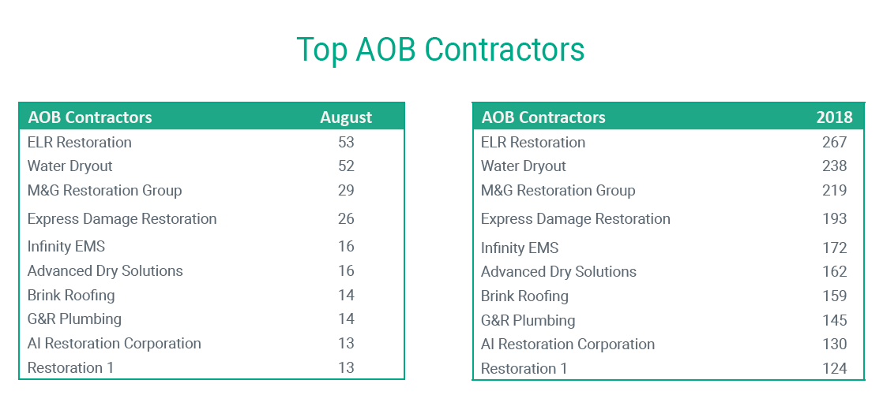

Slide 18
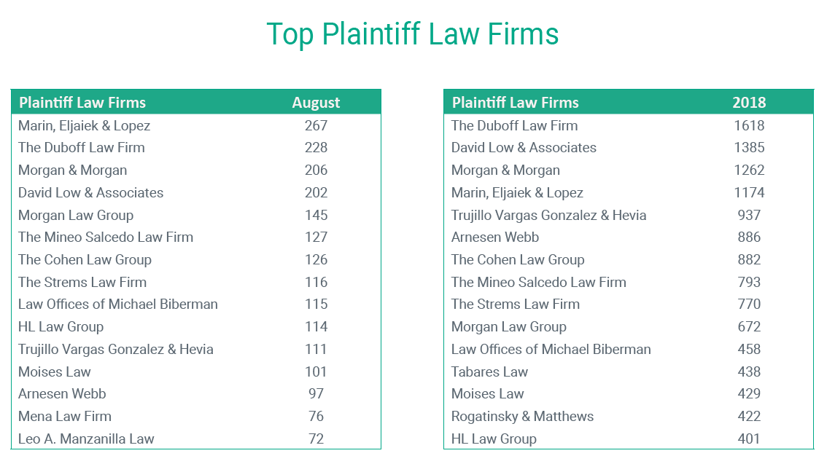

Slide 19
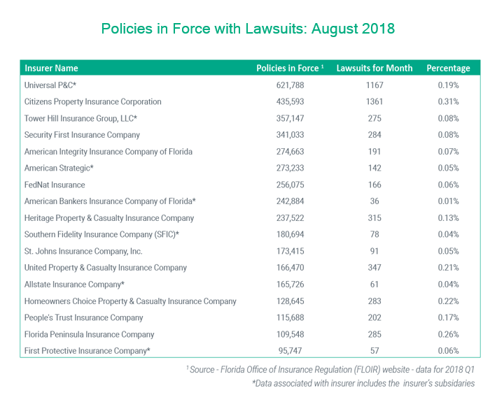

Slide 20
Mismanaged insurance can create irresponsible/fraudulent behavior
I.E. Insurable Interest
Two types--Individual and Societal
Albeit well-intended Usually the result of political and/or irresponsible, public policies
I.E—Replacement Cost Holdback, Bad Faith, Attorney Fee Statute, PA-fees, Assignment of Benefits, etc.
SOME IMPORTANT TAKEAWAYS!
Always ask about AOB, but…don’t trust. VERIFY!
No one ever has to sign an AOB. So, don’t do it!
Purge your lists. You Could still be liable!
BE PROACTIVE! Brochures, emails, advice to clients
Possible to rewrite contracts; contingencies, upon approval, et. & NO AOB! No Guarantees, but…?
Train your staff: no referral fee’s, no AOB’s, no excuses.

Slide 21
THE END
Johnson Strategies, LLC
Owner: Scott Johnson, AAI, CAE
WWW.johnsonstrategiesllc.com

