Slide 1
Florida Chamber Insurance Summit
Presented November 2018 by:
Barry Gilway, President/CEO & Executive Director
Miami, Florida

Slide 2
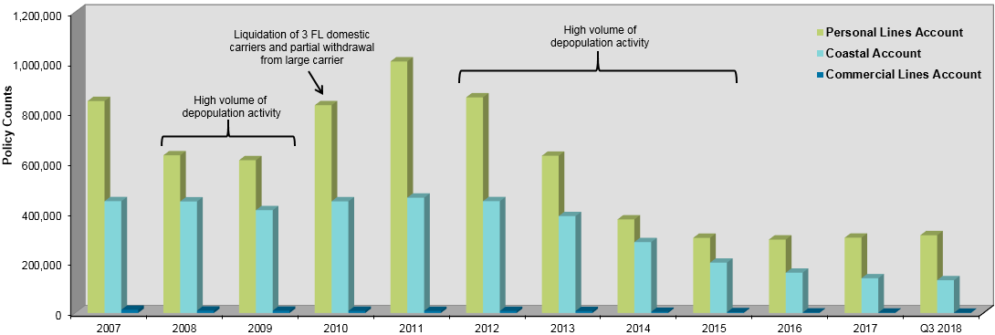
Portfolio Update (Policy Counts by Account and Year) as of December 31 unless otherwise noted

Slide 3
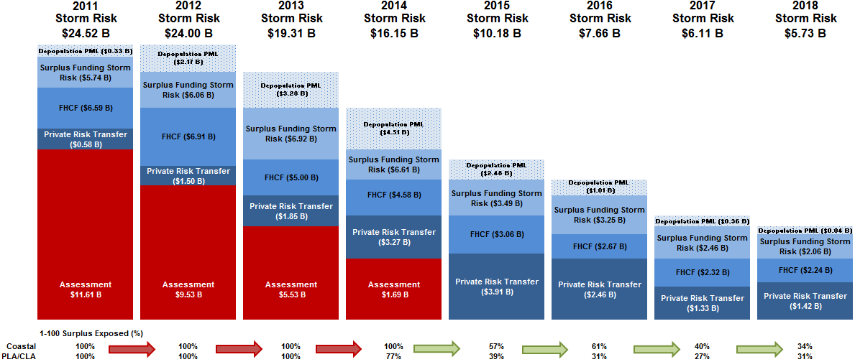
Assessment Risk
Public Summary of Citizens Assessment Reduction Efforts Over Time
NOT DRAWN TO SCALE
Notes:
Storm Risk is as measured by 1-in-100 year probable maximum loss (PML) plus estimated loss adjustment expenses using the Florida Hurricane Catastrophe Fund (FHCF) account allocation where PLA and CLA are combined. PLA/CLA combined PMLs are added to the Coastal PMLs to be consistent for surplus distribution. In general, the PMLs presented are as projected at the beginning of storm season; with the exception of 2017 which is as of August 31, 2017.
Surplus and Assessments are as projected at beginning of storm season. Not all PLA/CLA surplus is needed to fund storm risk in 2014. In 2015 - 2018, not all surplus in PLA/CLA and the Coastal Account is needed to fund storm risk. Remaining surplus is available to fund a second event.
Florida Hurricane Catastrophe Fund (FHCF) is as projected at beginning of storm season; with the exception of 2017 and 2018 which are Citizens' initial data submission to the FHCF.
Depopulation PMLs are not included in storm risk totals and are presented as year end totals; with the exception of 2018, which is as of May 31, 2018. PMLs from 2011-2014 use a weighted average of 1/3 Standard Sea Surface Temperature (SSST) and 2/3 Warm Sea Surface Temperature (WSST). 2015 - 2018 PMLs reflect only SSST event catalog.

Slide 4
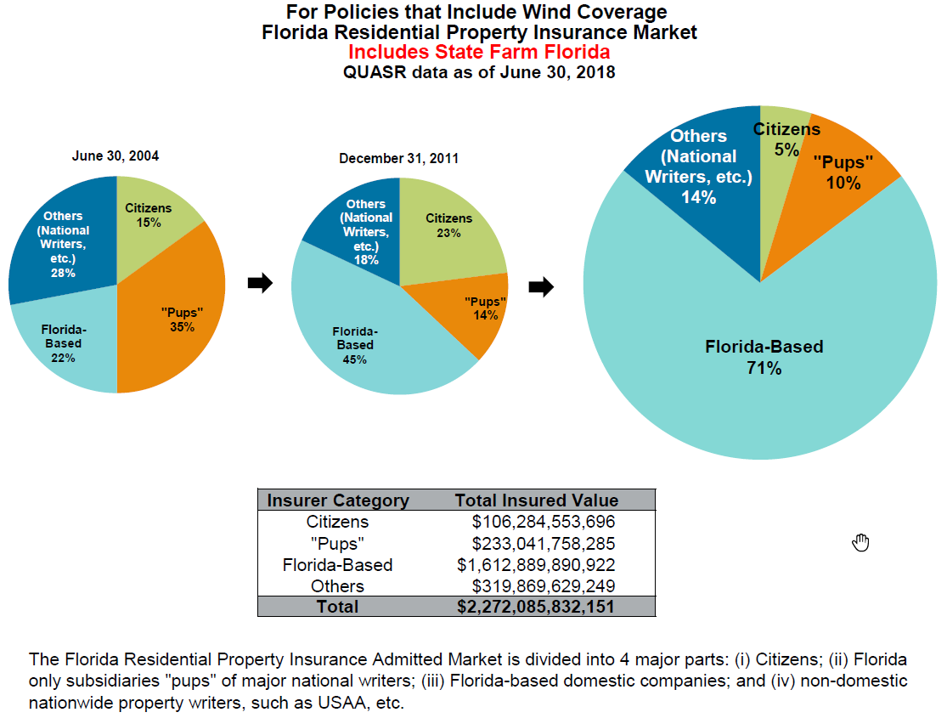
Market Share Based on Total Insured Value

Slide 5
Hurricane Update
Hurricane Irma
68,789 Claims Received
$1.84 Billion Booked Loss
Hurricane Michael
3,200 Claims Received
4,000 Forecast Claims
$142 Million Modeled Loss

Slide 6
Citizens Challenges
Litigation Increases
Tri-County Market Share
Tri-County Increased Litigation Factor
Rate Differential Between Citizens and Private Market
Increased Non-Weather Water Claims Due to Fraud and Abuse
Impact of Shift Away from Commercial and Coastal Wind Only

Slide 7
Carrier Litigation Expense
Litigation has been increasing steadily for all carriers.
Data source – DFS LSOP 2013-2018 Q3
Note: 2018 Q3 data includes Hurricane Irma which represents around 60% of all new Litigation for Citizens Property Insurance in 2018.

Slide 8
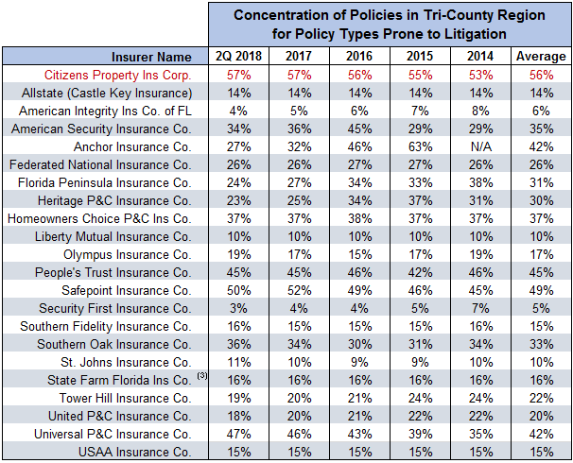
Citizens has Largest Concentration of Policies in the Tri-County Region

Slide 9
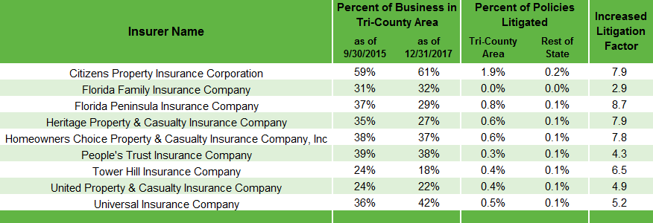
Concentration of Tri-County Policies Increases Litigation on Average 6 Times

Slide 10
Citizens Potential Solutions
Policy Language Changes / Managed Repair Caps
Requirements Prior to Initiating Litigation
Alternative Dispute Resolution Options
One Way Attorney Fee Revisions
Licensing of All Mitigation Contractors
Referral Fee Restrictions
Fraud – Increase Focus on Major Relationships

Slide 11
Questions and Discussion

