Slide 1
Frustrations & Explanations
Explaining the Insurance Claim Process
Presented by: Joseph Sabbagh

Slide 2
Joseph Sabbagh Public Insurance Adjuster
What is a Public Insurance Adjuster?
Public Insurance Adjusters represent the policyholder; not the insurance company.
Public Insurance Adjusters work exclusively for the policyholder.
Public Insurance Adjusters are licensed and bonded by the state, and specifically trained to adjust insurance claims.

Slide 3
Wind Policies vs. Flood Policies
Wind/Hurricane- only covers damages caused by the hurricane itself (ie: wind, rain, tornado, etc)
Flood- Federal program with limited coverages. Only covers damages caused by flooding.
Pointing fingers… Stories

Slide 4
What is the difference between the Adjuster and the Examiner?
Insurance Company’s Adjuster-
Documents the damages
Examiner- Gives the final say on coverage and settlement of your claim.
Problems with both…

Slide 5
So Who Are All Those Other People?
Field Adjuster vs. Independent Adjuster
Desk Adjuster vs. Examiner
An Examiner with the ability to set the right reserves for your claim.

Slide 6
Maximizing your claim
Know who you are arguing with
Florida statues that benefit policy holders:
Matching Clause (Wind policy)
Continuous
25% Rule (Wind policy)
Differences between Flood vs. Wind
Proof of Loss
Uncovered damages to your property can effect your tax liability–Speak to your Accountant

Slide 7
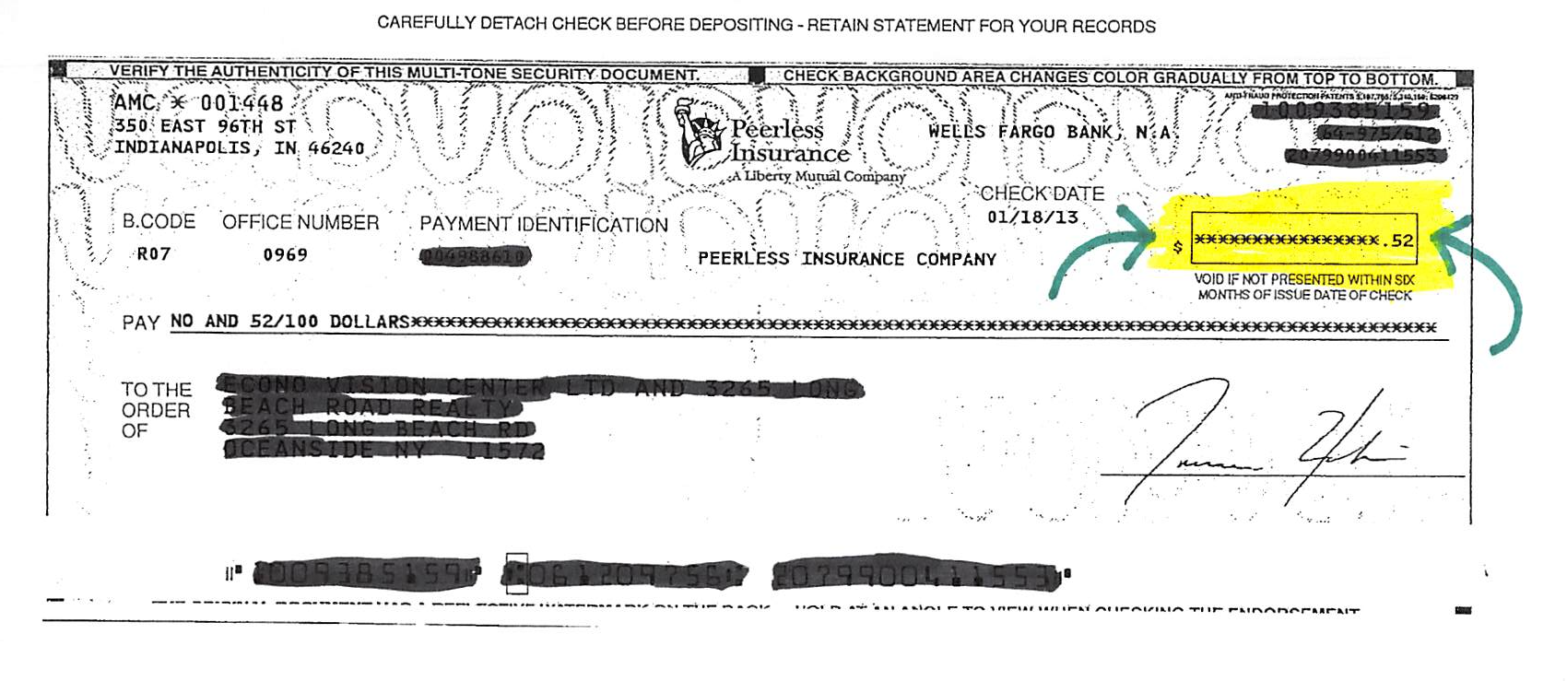
When offered a check from the insurance company, take it. No matter the amount, but don’t necessarily deposit it.

Slide 8
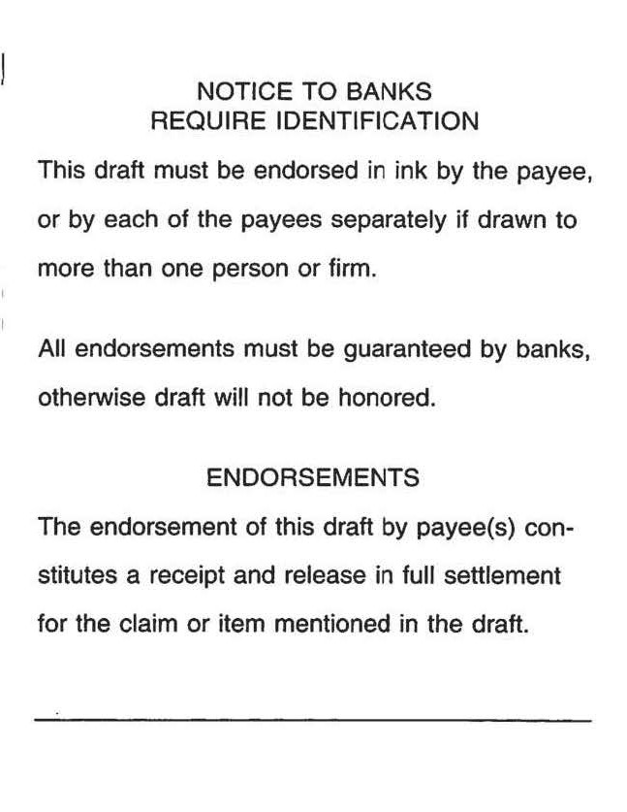
Warning- Some insurance companies add “Final Release” statements to the back of their checks.

Slide 9
Getting your Money from the Mortgage Company
Make sure the correct mortgage company is listed on your insurance policy.
Request their claim packet.
Find out their cap for insurance proceeds.
If you have already completed repairs, get them to inspect it.
FYI– Only Deposit checks at the Teller

