Slide 1
ASSIGNMENT OF BENEFITS: WHO PAYS?

Slide 2
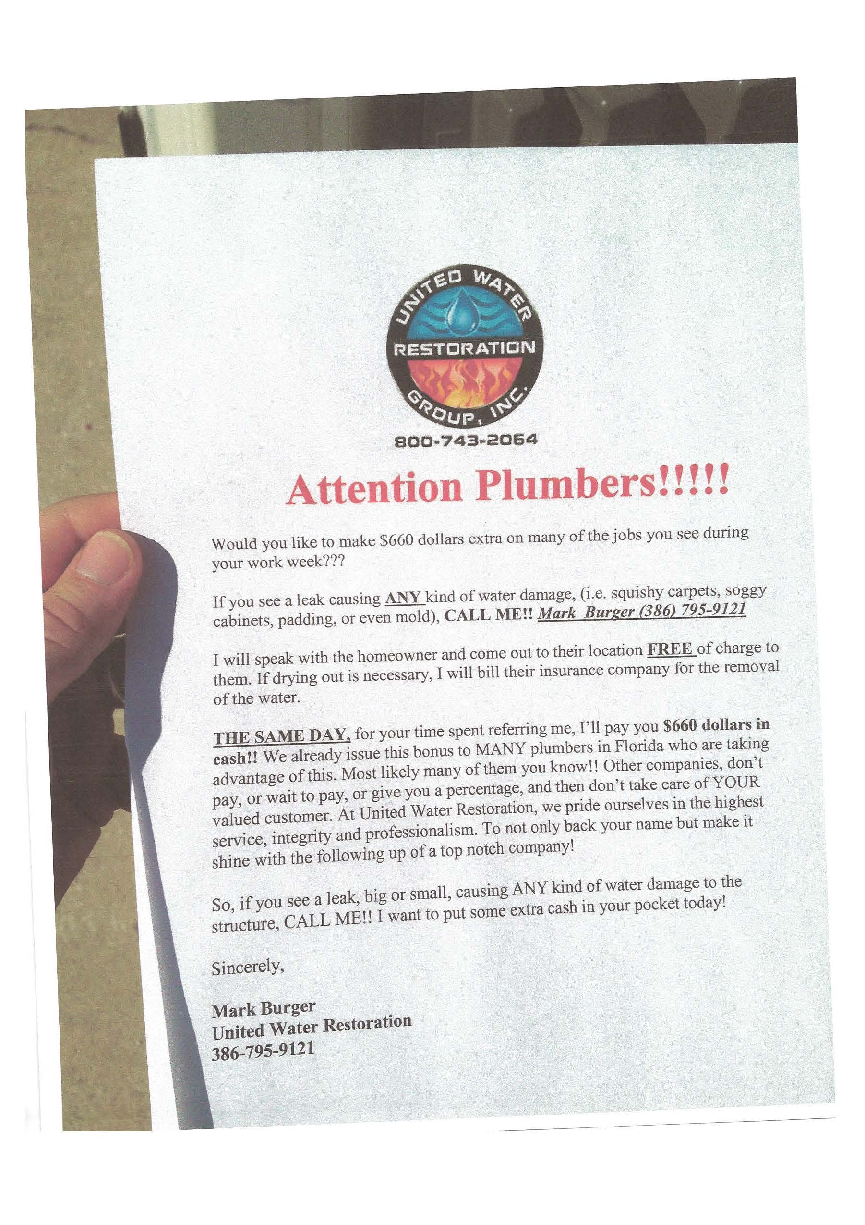

Slide 3
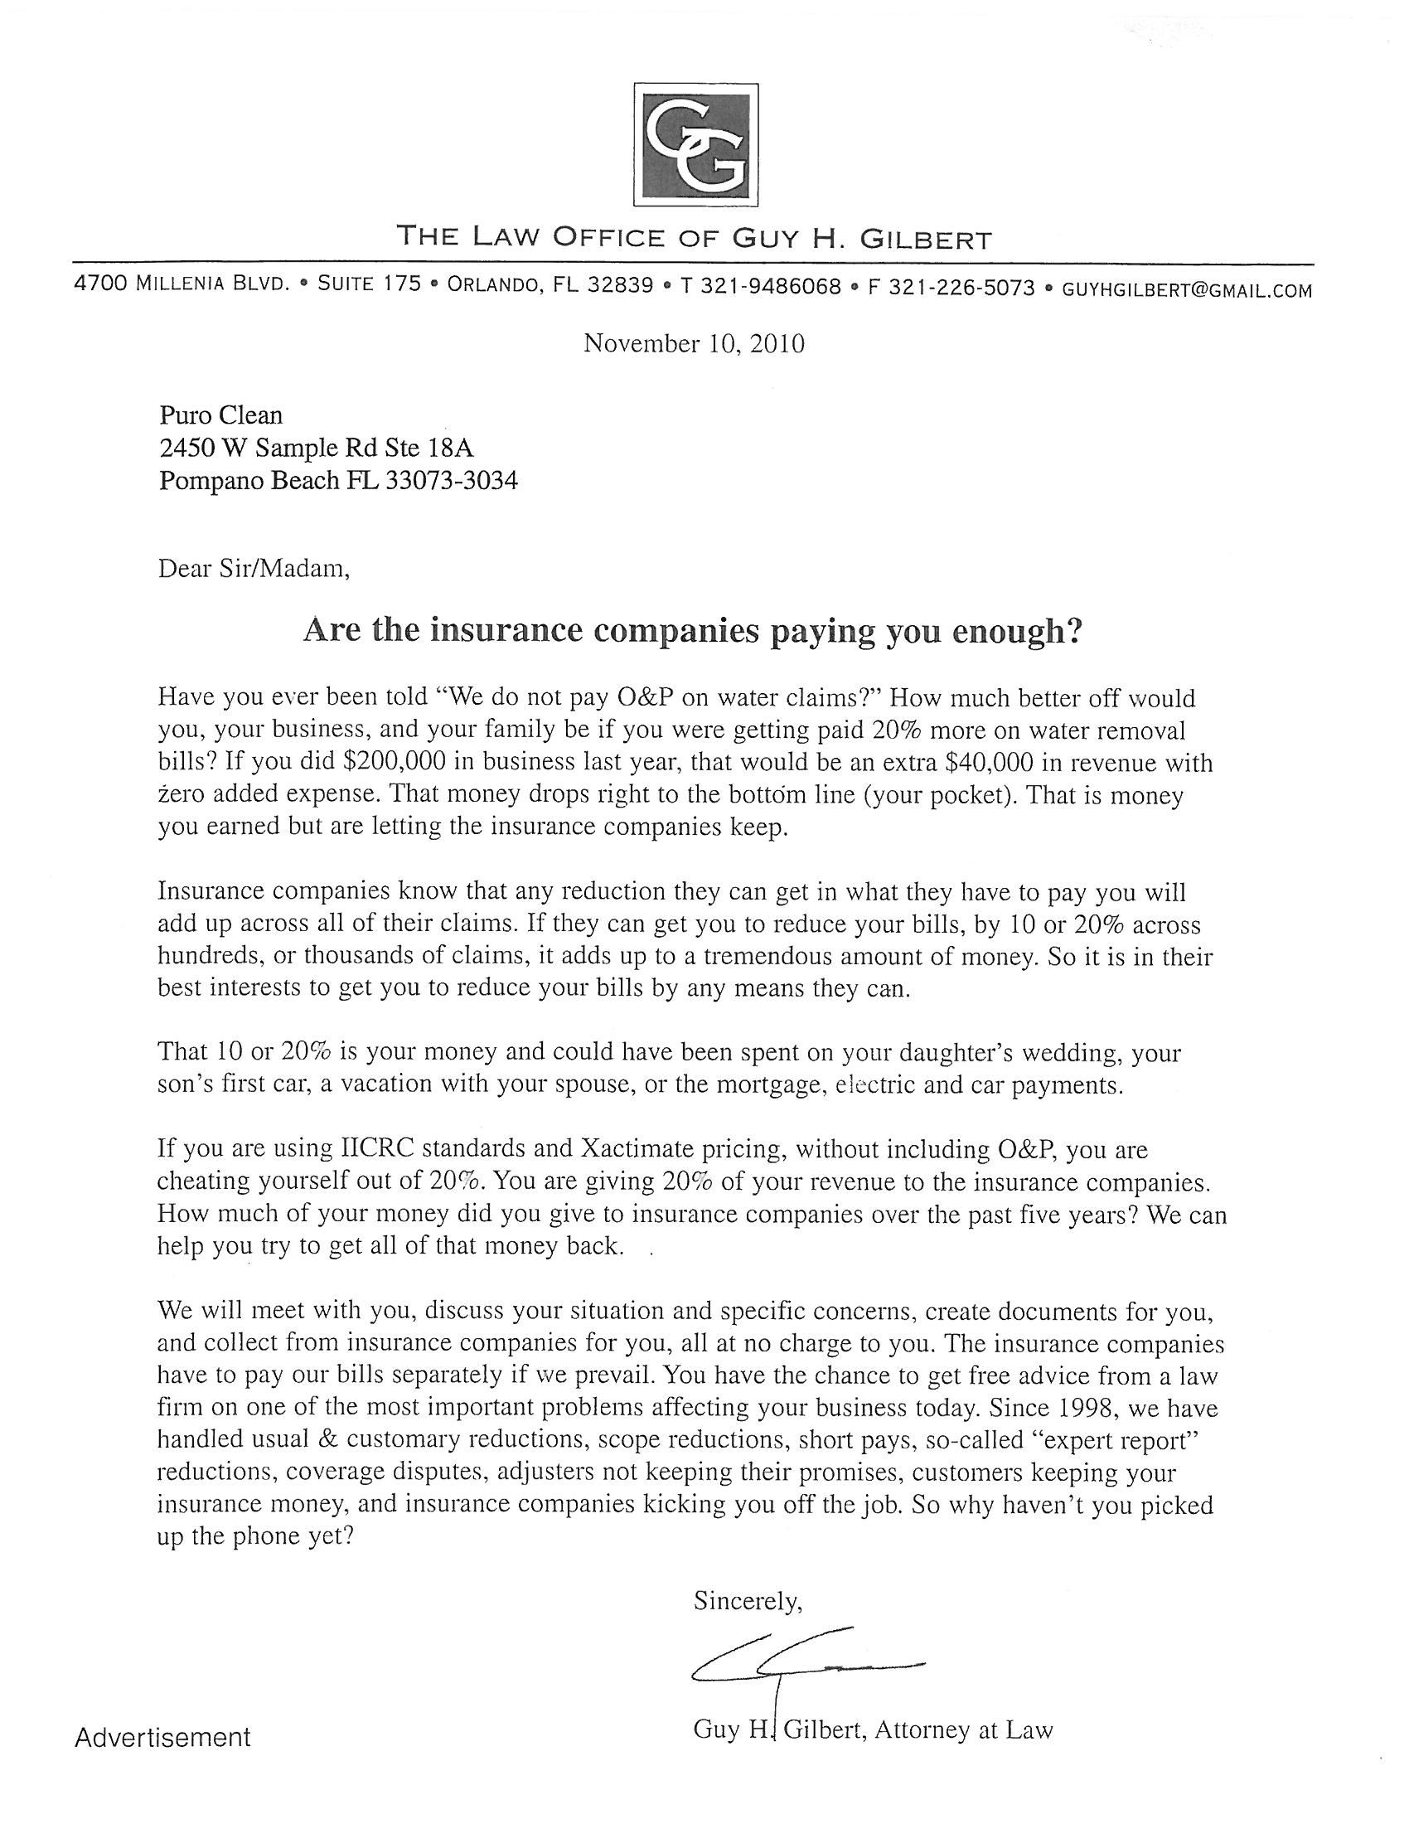

Slide 4
Miami-Dade Lawsuits by
Water & Restoration Companies

Slide 5



ASSIGNMENT OF BENEFITS
An assignment is the transfer of a complete and present interest in the item assigned. Most property insurance policies only allows a policyholder to assign an interest in post-loss benefits that are due and owning, as opposed to assigning the entire policy or claim, unless the insurer gives written consent.
  Legal document entitling the assignor to “stand in the shoes” of the assignee.
  Assigning the benefits of the insurance policy for a specific claim.

Slide 6
Lexington Ins. Co. v. Simkins Indus., Inc. 704 So.2d 1384 (Fla. 1998): An insurance policy “may be assignable, or not assignable, as provided by its terms” -- -- codified in section 627.422, Florida Statutes, which provides:
A policy may be assignable, or not assignable, as provided by its terms. Subject to its terms relating to assignability, any life or health insurance policy under the terms of which the beneficiary may be changed upon the sole request of the policy owner may be assigned either by pledge or transfer of title, by an assignment executed by the policy owner alone and delivered to the insurer, whether or not the pledgee or assignee is the insurer...

Slide 7
Policy Provision:
SECTIONS I & II – CONDITIONS
***
E. Assignment
Assignment of this policy will not be valid unless we give our written consent

Slide 8

Contractors and Unlicensed
Public Adjusting
    Department of Financial Services Warning About Contractors and Unlicensed Public Adjusting. Some contractors may offer to assist an insurance claim. If the scope of assistance provided by the contractor exceeds the scope of their license, they may be illegally engaging in the practice of unlicensed public adjusting. A public adjuster, as outlined in Section 626.854, Florida Statutes, is any person, except an attorney, who, for money or any other thing of value (which would include securing a contract for repairs):
      Prepares, completes or files an insurance claim form for an insured;
      Aids in any manner on behalf of an insured in negotiating for or effecting the settlement of a claim, or
      Advertises or solicits for employment as an adjuster of such claims;
    ii. Any contractor acting as a public adjuster could be subject to arrest and may be charged with a third-degree felony as provided by Section 626.8738, Florida Statutes.

Slide 9
Claim Investigation
Request Examination Under Oath of insured and cc the AOB.
Request documents, including estimate of damage, dry out logs, diagrams, photos, expense verification, etc.
Request detailed information about the laborers who did the work, i.e. time sheets, mileage logs, etc.
Review invoices for material sales tax. If listed, request copies of invoices for materials and proof that taxes are remitted to the state.
Request license of each person who inspected the property and performed any work.
Request affidavit from AOB affirming scope of estimate or work completed.

Slide 10


The Rock Law Group
1760 Fennell Street
Maitland FL, 32751
Tel: 407-647-9881
Fax: 407-647-9867
www.rocklawpa.com

