Slide 1
Florida Insurance Conference on Financial Reporting
Citizens Property Insurance Corporation
Sharon A. Binnun, CPA
September 2011

Slide 2
Basics re: Citizens
Unlike a private insurer, Citizens does not have the ability to manage its book of business so that the exposure matches its surplus and reinsurance program. Citizens accepts most risks and its wind risk far exceeds its surplus and reinsurance.
Add rate inadequacy to the mix and …assessments could occur if there is a large storm or multiple small storms.
While Citizens is in its best ever financial position, with projected 2011 combined surplus + FHCF reimbursements + private reinsurance of just over $16.7 billion, we continue to rely on assessments to fund catastrophe losses in the event of a large storm or several smaller storms.
1
Notes:
1

Slide 3
Market Share
Coastal Account has over 65% market share
CLA has approximately 53% market share
PLA has approximately 20% market share
PLA is the book of business experiencing significant growth since 1/1/10 and is most ripe for depopulation and keep out programs
2
Notes:
2

Slide 4
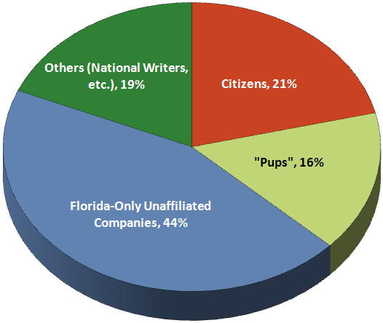
Florida Residential Property Admitted Market Breakdown
As of March 31, 2011
June 30, 2004
The Florida Residential Property Insurance Admitted Market is divided into 4 major parts: (1) Citizens; (2) the Florida only subsidiaries “pups” of the major national writers; (3) the Florida-only domestic companies; and (4) non-domestic nationwide property writers, such as USAA, etc.
Source: Florida Office of Insurance Regulation, Quarterly Supplemental Report (QUASR). Includes licensed carriers only. Surplus lines companies are not included. Based on insured value for policies with wind coverage.
3
Notes:
3

Slide 5
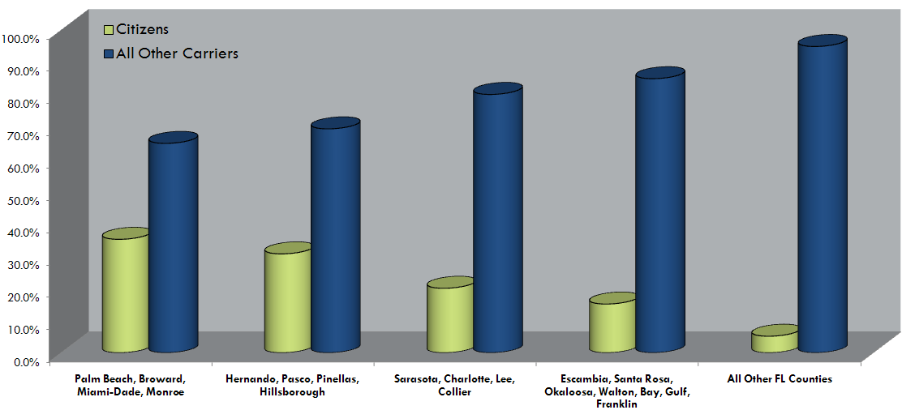
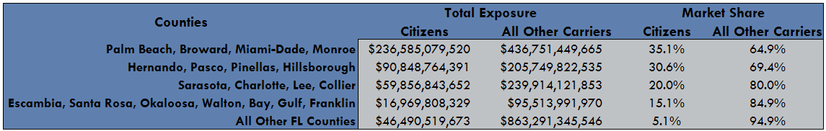
Florida Residential Property Market – Citizens vs. All Other Carriers Market Share
As of March 31, 2011
Source: Florida Office of Insurance Regulation, Quarterly Supplemental Report (QUASR). Includes licensed carriers only. Surplus lines companies are not included. Based on insured value for policies with and without wind coverage.
4
Notes:
4

Slide 6
The Current State of the Market
When the private market writes less, Citizens writes more.
CLA and Coastal Account PIF relatively steady.
Significant growth in the PLA.
5
Notes:
5

Slide 7
Significant Growth Only in the Personal Lines Account (PLA)
  Why do policies come to Citizens?
    Price - Premium is likely lower than private market
    Agents
      Captive agents
      Citizens cannot become insolvent
      Price
    Less stringent underwriting requirements
    Coverage - Until 2012, Citizens covered pool cages and carports
    Sinkhole territories
    Wind Mitigation Credit factor
    Few private companies want to write Commercial Residential policies and/or Coastal properties
6
Notes:
6

Slide 8
Financing
  Pre-Event Bonds
    Issued to provide liquidity for timely payment of valid claims
    Debt service is paid from operating funds and bond proceeds themselves
    Can be issued taxable or tax exempt
  Post -Event Bonds
    Triggered by Emergency Assessments
    Very unlikely for PLA/CLA
    2% probability for Coastal Account
    Emergency Assessments can be levied over a number of years
    Debt service is paid by Emergency Assessments
  Citizens credit
    Rated A+ stable by S&P and Fitch; A2 stable by Moody’s
    Strength of credit
      Ability to levy assessments
      Participation in the FHCF
      Strong non-impairment language in the statute
      Name change from HRA to Coastal Account
    Different from FHCF
7
Notes:
7

Slide 9
Citizens’ Investment Portfolio
As of June 30, 2011
8
Notes:
8

Slide 10
Estimated Claims-Paying Ability – 2011 Hurricane Season
 | $'s in Millions
Description | Personal & Commercial Lines Accounts | Coastal Account | Total
Beginning Accumulated Surplus¹ | $ 2,770 | $ 2,332 | $ 5,102
Budgeted Net Income² | 286 | 354 | 640
Total Accumulated Surplus available for claims | $ 3,056 | $ 2,686 | $ 5,742
Pre-Event Liquidity Available³ | - | 3,821 | 3,821
Projected FHCF Coverage (Mandatory Layer Only)⁴ | 2,581 | 4,010 | 6,591
Private Reinsurance⁵ | - | 575 | 575
Total 2011 Projected Claims-Paying Ability | $ 5,637 | $ 11,092 | $ 16,729
Notes:
¹ Accumulated Surplus (audited) as of December 31, 2009, plus audited 2010 net income and other changes in surplus.
² Approved by the Board of Governors.
³ Includes a provision for the issuance approved by Citizens' Board of Governors on May 11, 2011, of $900 million, which closed on July 14, 2011. Pre- Event liquidity does not represent risk transfer and any funds drawn must be repaid.
⁴ FHCF coverage is based on estimates of preliminary exposure data, rating factors and coverage multiples. The final retention and coverage amounts may be significantly different from these estimates.
⁵ Assumes the occurrence of an event or events sufficient to pierce and exhaust private reinsurance coverage.
9
Notes:
9

Slide 11
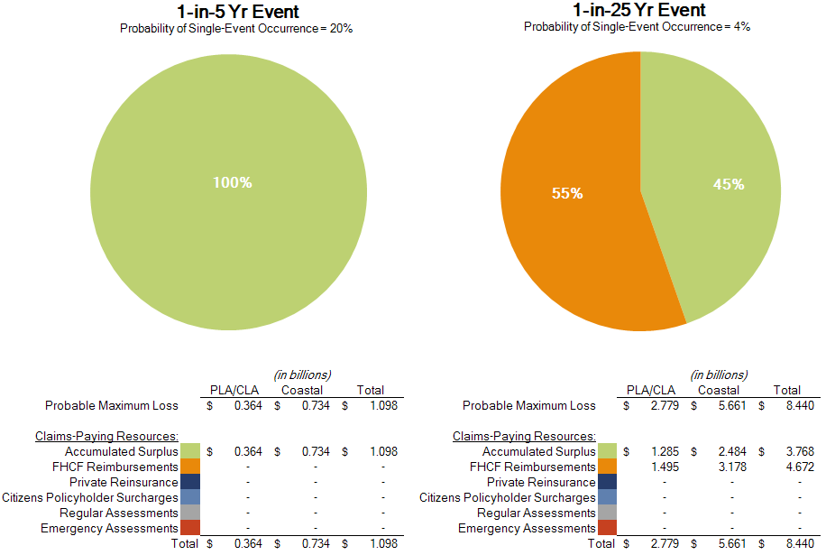
Projected Claims Paying Resources - Combined Accounts
2011 Hurricane Season¹
¹ See Notes & Assumptions attached hereto
10
Notes:
10

Slide 12
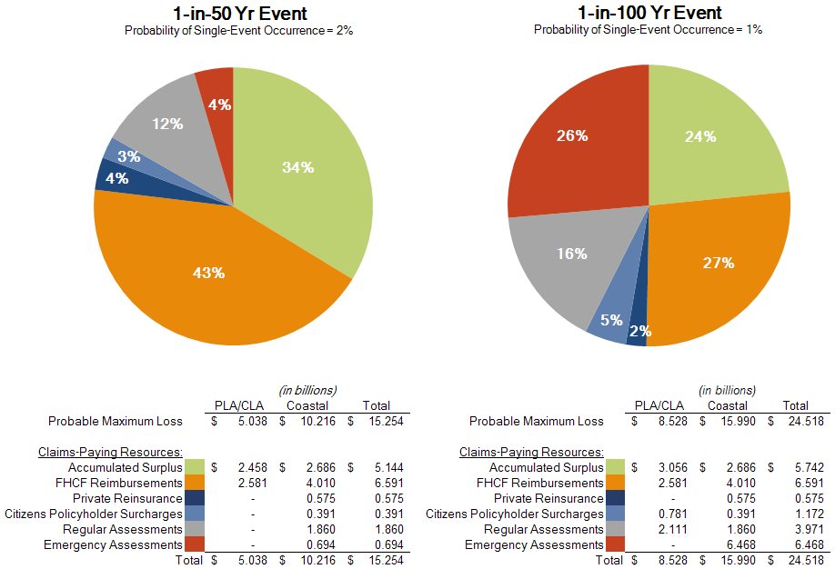
Projected Claims Paying Resources - Combined Accounts
2011 Hurricane Season¹
¹ See Notes & Assumptions attached hereto
11
Notes:
11

Slide 13
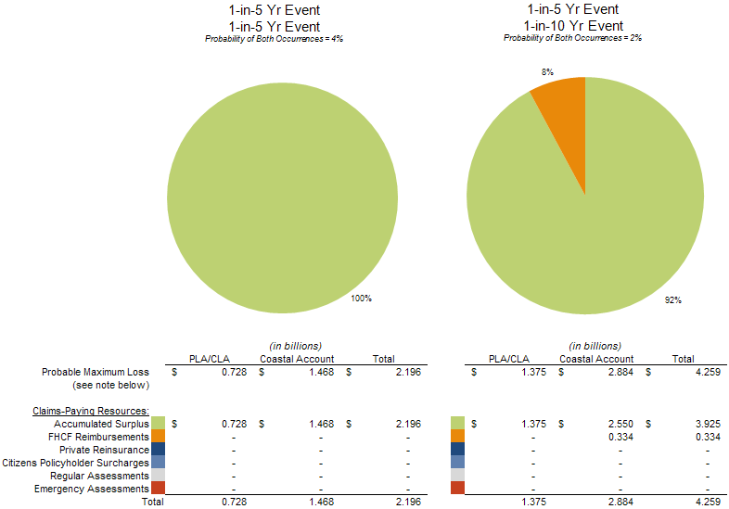
Projected Claims Paying Resources - Combined Accounts
2011 Hurricane Season¹
¹ See Notes & Assumptions attached hereto
12
Notes:
12

Slide 14
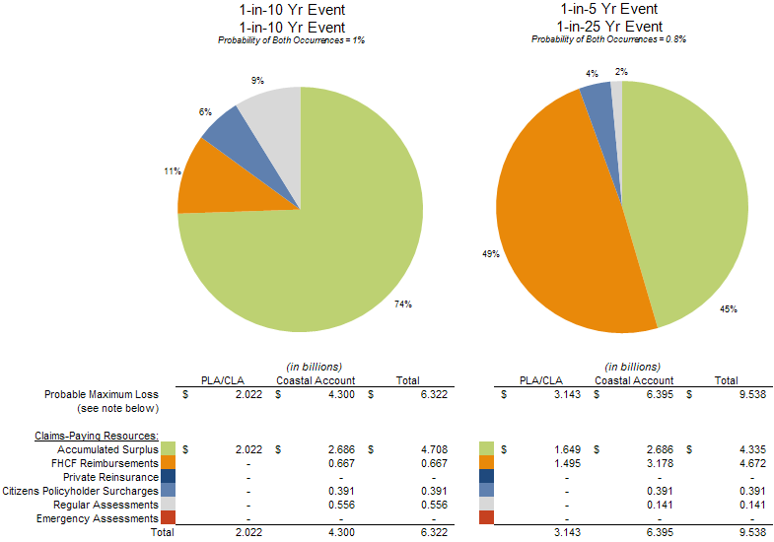
Projected Claims Paying Resources - Combined Accounts
2011 Hurricane Season¹
¹ See Notes & Assumptions attached hereto
13
Notes:
13

Slide 15
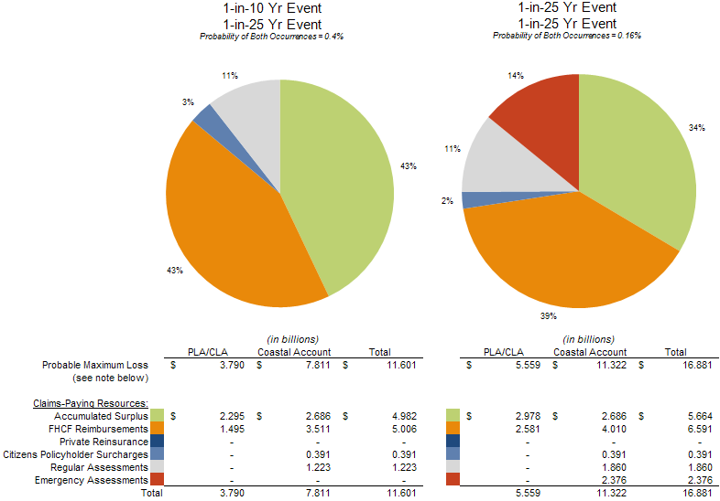
Projected Claims Paying Resources - Combined Accounts
2011 Hurricane Season¹
¹ See Notes & Assumptions attached hereto
14
Notes:
14

Slide 16
Actuarially Sound Rates
  Even if actuarially sound, assessments could be triggered depending on amount of losses in a season (severe single event or multiple events)
  When Citizens’ rates are actuarially sound, such rates could still be less than private market due to differences in cost structure
    No taxes
    No profit/ return to investors
    Lower administrative expenses as a governmental entity
    Less reinsurance than private market
    Lower commissions, no contingent commissions, profit sharing
    No advertising
15
Notes:
15

Slide 17
Summary of Indicated Statewide Rate Changes – Wind and Other Perils
Personal Lines Excludes Sinkhole
Product Line | Type of Policy | 12/31/2010 Total Inforce Premium at Current Rate Level | Indicated Uncapped Rate Change Including a Provision for FHCF Build-Up | 12/31/2010 Total Inforce Non-Sinkhole Premium at Current Rate Level | Indicated Uncapped Non-Sinkhole Rate Change | Capped Rate Change Including a Provision for FHCF Build-Up | Capped Rate Change Excluding a Provision for FHCF Build-Up
PRM & PRW | Homeowners - HO3 | 1,395,919,501 | 51.4% | 1,352,031,891 | 35.0% | 9.4% | 8.0%
PRM & PRW | Renters - HO4 | 6,138,568 | 16.7% | 6,138,568 | 15.8% | -0.2% | -0.6%
PRM & PRW | Condos Unit Owner - HO6 | 93,751,667 | 28.9% | 93,751,667 | 26.8% | 4.2% | 3.3%
PRM | Dwelling-DP1 | 32,492,292 | 59.9% | 32,239,058 | 49.8% | 10.9% | 9.5%
PRM & PRW | Dwelling-DP3/DW2 | 363,291,468 | 48.6% | 357,783,934 | 36.3% | 8.8% | 7.5%
PRM & PRW | Mobile Home | 106,054,609 | 11.2% | 106,054,609 | 8.8% | 4.8% | 3.4%
PRM & PRW | Mobile Home Dwelling | 66,599,240 | 8.0% | 66,599,240 | 6.0% | 3.2% | 2.1%
PRM & PRW | Total | $ 2,064,247,345 | 46.5% | $ 2,014,598,965 | 32.8% | 8.6% | 7.2%
CRW | Condo | 108,192,970 |  | 108,192,970 | 80.8% | 13.5% | 9.9%
CRW | Apartment | 30,305,576 |  | 30,305,576 | 75.0% | 13.7% | 10.0%
CRW¹ | Total | $ 138,498,546 |  | $ 138,498,546 | 79.5% | 13.6% | 9.9%
CNRW | Total | $ 80,107,521 |  | $ 80,107,521 | 78.8% | 10.0% | 10.0%
CRM | Condo | 173,985,703 |  | 173,985,703 | 18.3% | 5.2% | 3.8%
CRM | Apartment | 48,258,265 |  | 48,258,265 | 22.6% | 11.3% | 9.9%
CRM¹ | Total | $ 222,243,968 |  | $ 222,243,968 | 19.2% | 6.6% | 5.1%
Grand Total |  | $ 2,505,097,380 |  | $ 2,455,449,000 | 35.6% | 8.8% | 7.3%
¹ Does Not include a-rated, special class, or specifically rated policies
16
Notes:
16

Slide 18
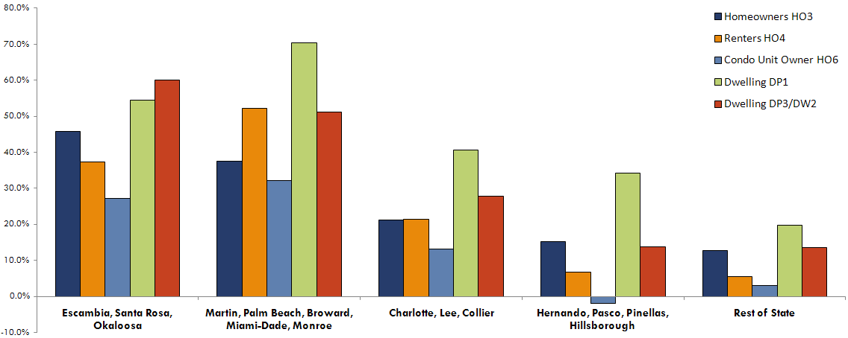
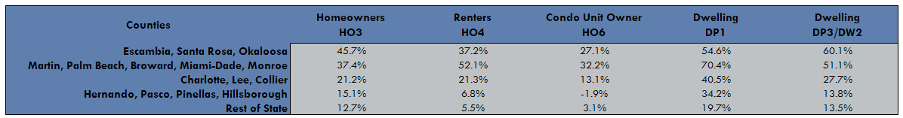
Personal Residential Regional Average Indicated Rate Change by Policy Type
Wind and Other Perils (Excludes Sinkhole)
17
Notes:
17

Slide 19
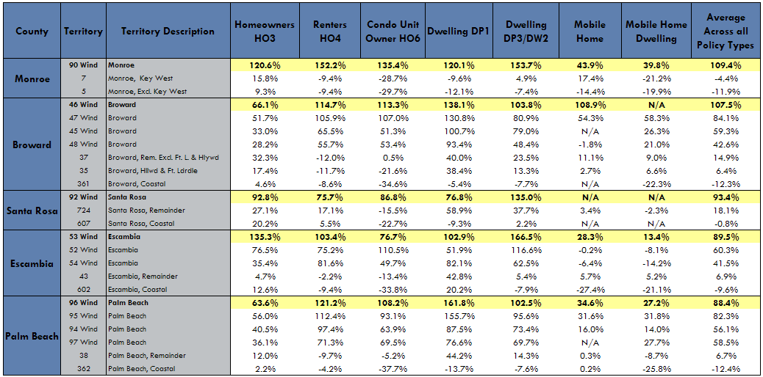
Indicated Wind and Other Perils Rate Change by Policy Type
Top Five Territories Based on Average Across all Policy Types
(Excludes Sinkhole)
18
Notes:
18

Slide 20
Summary of Indicated Statewide Rate Changes – Sinkhole Only
Product Line | Type of Policy | 12/31/2010 Total Inforce Premium at Current Rate Level | Indicated Uncapped Rate Change Including a Provision for FHCF Build-Up¹ | 12/31/2010 Total Inforce Sinkhole Premium at Current Rate Level | Indicated Uncapped Rate Change for Sinkhole Only | Proposed Uncapped Rate Change for Sinkhole Only
PRM & PRW | Homeowners - HO3 | 1,395,919,501 | 51.4% | 43,887,611 | 443.6% | 443.6%
PRM & PRW | Renters - HO4 | 6,138,568 | 16.7% | 0 | n/a | n/a
PRM & PRW | Condos Unit Owner - HO6 | 93,751,667 | 28.9% | 0 | n/a | n/a
PRM | Dwelling-DP1 | 32,492,292 | 59.9% | 253,234 | 914.6% | 914.6%
PRM & PRW | Dwelling-DP3/DW2 | 363,291,468 | 48.6% | 5,507,535 | 649.4% | 649.4%
PRM & PRW | Mobile Home | 106,054,609 | 11.2% | 0 | n/a | n/a
PRM & PRW | Mobile Home Dwelling | 66,599,240 | 8.0% | 0 | n/a | n/a
PRM & PRW | Total | $ 2,064,247,345 | 46.5% | $ 49,648,380 | 428.6% | 428.6%
¹ Indicated rate change excluding sinkhole
19
Notes:
19

Slide 21
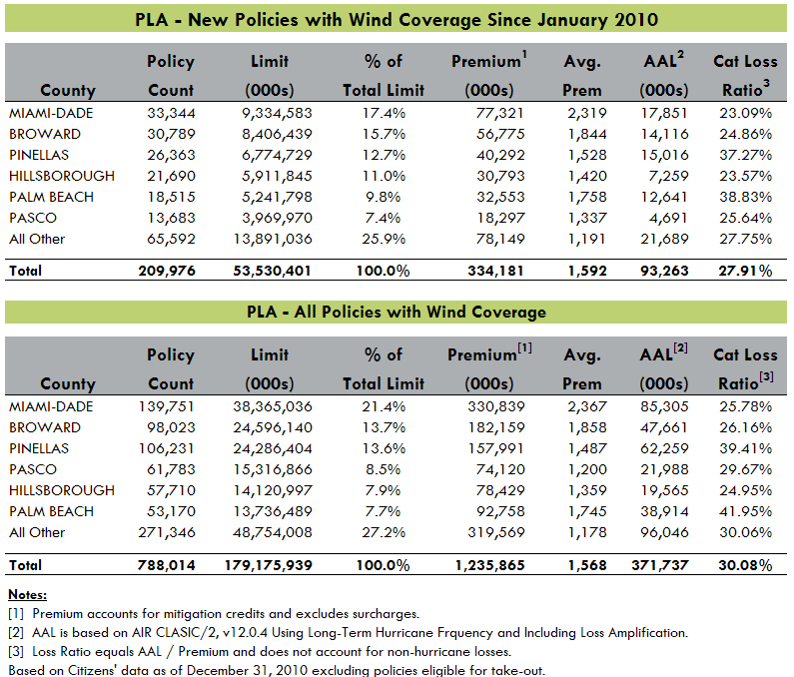
Characteristics for Potential Take-Out Policies - Location
20
Notes:
20

Slide 22
Wind Mitigation Credits Trend Analysis
As of December 31, 2010
21
Notes:
21

Slide 23
Average Wind Mitigation Credits
As of December 31, 2010
Personal Residential Policies with WMC
Commercial Residential Policies with WMC
22
Notes:
22

Slide 24
Inspection Program
32,628 personal residential and commercial lines inspections have been fully processed as of May 31, 2011
The estimated increase in premium as a result of these inspections is $15,535,192
Future plans for the program:
Expand the scope to include new business
Commercial multiple building inspections
Retail inspections
Allow for additional inspection types such as four point, general condition, and mobile home tie down
23
Notes:
23

Slide 25
Appendix

Slide 26
Projected Claims-Paying Resources – Notes & Assumptions
25
Notes:
25

